Slide 1
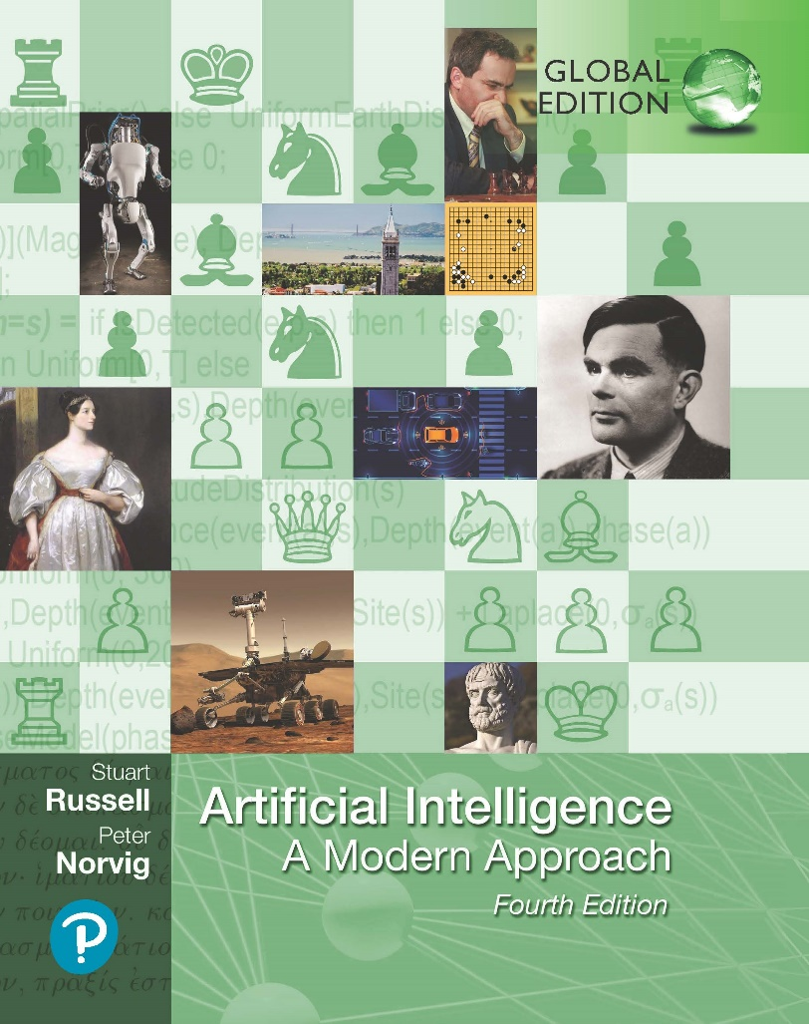
Artificial Intelligence: A Modern Approach
Fourth Edition, Global Edition
Chapter 2
Intelligent Agents

Slide 2
Outline
What is AI?
Agents and environments
Rationality
PEAS (Performance measure, Environment, Actuators, Sensors)
Environment types
Agent types

Slide 3
What is AI?
Systems that think like humans | Systems that think rationally
Systems that act like humans | Systems that act rationally

Slide 4
Acting humanly: The Turing test
Turing (1950) “Computing machinery and intelligence”:
“Can machines think?” −→ “Can machines behave intelligently?”
Operational test for intelligent behavior: the Imitation Game
HUMAN
HUMAN INTERROGATOR
?
AI SYSTEM
Predicted that by 2000, a machine might have a 30% chance of fooling a lay person for 5 minutes
Anticipated all major arguments against AI in following 50 years
Suggested major components of AI: knowledge, reasoning, language understanding, learning
Problem: Turing test is not reproducible, constructive, or amenable to mathematical analysis

Slide 5
Thinking humanly: Cognitive Science
1960s “cognitive revolution”: information-processing psychology replaced prevailing orthodoxy of behaviorism
Requires scientific theories of internal activities of the brain
What level of abstraction? “Knowledge” or “circuits”?
How to validate? Requires
  Predicting and testing behavior of human subjects (top-down) or 2) Direct identification from neurological data (bottom-up)
Both approaches (roughly, Cognitive Science and Cognitive Neuroscience) are now distinct from AI
Both share with AI the following characteristic:
the available theories do not explain (or engender) anything resembling human-level general intelligence
Hence, all three fields share one principal direction!

Slide 6
Thinking rationally: Laws of Thought
Normative (or prescriptive) rather than descriptive
Aristotle: what are correct arguments/thought processes? Several Greek schools developed various forms of logic:
notation and rules of derivation for thoughts;
may or may not have proceeded to the idea of mechanization
Direct line through mathematics and philosophy to modern AI Problems:
Not all intelligent behavior is mediated by logical deliberation
What is the purpose of thinking? What thoughts should I have out of all the thoughts (logical or otherwise) that I could have?

Slide 7
Acting rationally
Rational behavior: doing the right thing
The right thing: that which is expected to maximize goal achievement, given the available information
Doesn’t necessarily involve thinking—e.g., blinking reflex—but thinking should be in the service of rational action
Aristotle (Nicomachean Ethics):
Every art and every inquiry, and similarly every action and pursuit, is thought to aim at some good

Slide 8
AI prehistory
Philosophy
logic, methods of reasoning mind as physical system
foundations of learning, language, rationality
formal representation and proof
algorithms, computation, (un)decidability, (in)tractability probability
adaptation
phenomena of perception and motor control experimental techniques (psychophysics, etc.)
formal theory of rational decisions knowledge representation grammar
plastic physical substrate for mental activity
Mathematics
Psychology
Economics Linguistics
Neuroscience
Control theory homeostatic systems, stability
simple optimal agent designs

Slide 9
Potted history of AI
1943
1950
McCulloch & Pitts: Boolean circuit model of brain Turing’s “Computing Machinery and Intelligence”
1952–69 Look, Ma, no hands!
1950s
Early AI programs, including Samuel’s checkers program, Newell & Simon’s Logic Theorist, Gelernter’s Geometry Engine Dartmouth meeting: “Artificial Intelligence” adopted Robinson’s complete algorithm for logical reasoning
1956
1965
1966–74 AI discovers computational complexity Neural network research almost disappears
1969–79 Early development of knowledge-based systems
1980–88 Expert systems industry booms
1988–93 Expert systems industry busts: “AI Winter”
1985–95 Neural networks return to popularity
1988–
Resurgence of probability; general increase in technical depth “Nouvelle AI”: ALife, GAs, soft computing
Agents, agents, everywhere . . .
Human-level AI back on the agenda
1995–
2003–

Slide 10
Rational agents
An agent is an entity that perceives and acts
This course is about designing rational agents
Abstractly, an agent is a function from percept histories to actions:
f : P∗ → A
For any given class of environments and tasks, we seek the agent (or class of agents) with the best performance
Caveat: computational limitations make perfect rationality unachievable
→ design best program for given machine resources

Slide 11
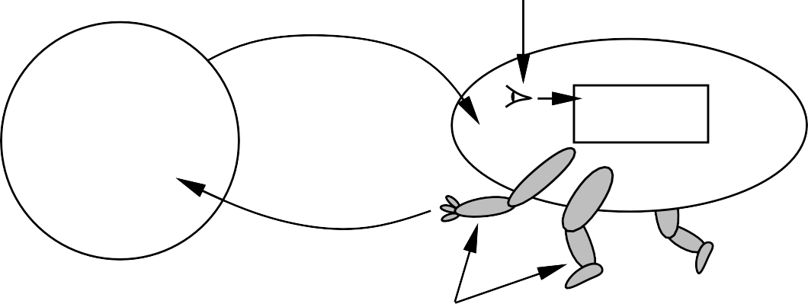
Agents and environments
sensors
percepts
?
agent
environment
actions
actuators
Agents include humans, robots, softbots, thermostats, etc.
An agent can be anything that can be viewed as perceiving its environment through sensors and acting upon that environment through actuators
The agent function maps from percept histories to actions:
f : P∗ → A
The agent program runs on the physical architecture to produce f

Slide 12







Vacuum-cleaner world
A B
Percepts: location and contents, e.g., [A, Dirty]
Actions: Left, Right, Suck, N oOp

Slide 13
A vacuum-cleaner agent
Percept sequence | Action
[A, Clean] | Right
[A, Dirty] | Suck
[B, Clean] | Left
[B, Dirty] | Suck
[A, Clean], [A, Clean] | Right
[A, Clean], [A, Dirty] | Suck
. | .
function Reflex-Vacuum-Agent( [location,status]) returns an action
if status = Dirty then return Suck else if location = A then return Right else if location = B then return Left
What is the right function?
Can it be implemented in a small agent program?

Slide 14
PEAS
To design a rational agent, we must specify the task environment
Consider, e.g., the task of designing an automated taxi: Performance measure??
Environment?? Actuators??
Sensors??

Slide 15
PEAS
To design a rational agent, we must specify the task environment
Consider, e.g., the task of designing an automated taxi:
Performance measure?? safety, destination, profits, legality, comfort, . . .
Environment?? US streets/freeways, traffic, pedestrians, weather, . . .
Actuators?? steering, accelerator, brake, horn, speaker/display, . . .
Sensors?? video, accelerometers, gauges, engine sensors, keyboard, GPS, . . .

Slide 16
Internet shopping agent
Performance measure??
Environment?? Actuators??
Sensors??

Slide 17
Internet shopping agent
Performance measure?? price, quality, appropriateness, efficiency
Environment?? current and future WWW sites, vendors, shippers Actuators?? display to user, follow URL, fill in form
Sensors?? HTML pages (text, graphics, scripts)

Slide 18
Environment types
 | Solitaire Backgammon Internet shopping Taxi
Observable?? Deterministic?? Episodic?? Static?? Discrete?? Single-agent??

Slide 19
Environment types
 | Solitaire Backgammon Internet shopping Taxi
Observable?? Deterministic?? Episodic?? Static?? Discrete?? Single-agent?? | Yes Yes No No

Slide 20
Environment types
 | Solitaire Backgammon Internet shopping Taxi
Observable?? Deterministic?? Episodic?? Static?? Discrete?? Single-agent?? | Yes Yes No No Yes No Partly No

Slide 21
Environment types
 | Solitaire Backgammon Internet shopping Taxi
Observable?? Deterministic?? Episodic?? Static?? Discrete?? Single-agent?? | Yes Yes No No Yes No Partly No No No No No

Slide 22
Environment types
 | Solitaire Backgammon Internet shopping Taxi
Observable?? Deterministic?? Episodic?? Static?? Discrete?? Single-agent?? | Yes Yes No No Yes No Partly No No No No No Yes Semi Semi No

Slide 23
Environment types
 | Solitaire Backgammon Internet shopping Taxi
Observable?? Deterministic?? Episodic?? Static?? Discrete?? Single-agent?? | Yes Yes No No Yes No Partly No No No No No Yes Semi Semi No Yes Yes Yes No

Slide 24
Environment types
 | Solitaire Backgammon Internet shopping Taxi
Observable?? Deterministic?? Episodic?? Static?? Discrete?? Single-agent?? | Yes Yes No No Yes No Partly No No No No No Yes Semi Semi No Yes Yes Yes No Yes No Yes (except auctions) No
The environment type largely determines the agent design
The real world is (of course) partially observable, stochastic, sequential, dynamic, continuous, multi-agent

Slide 25
Agent types
Four basic types in order of increasing generality:
simple reflex agents
reflex agents with state
goal-based agents
utility-based agents
All these can be turned into learning agents

Slide 26
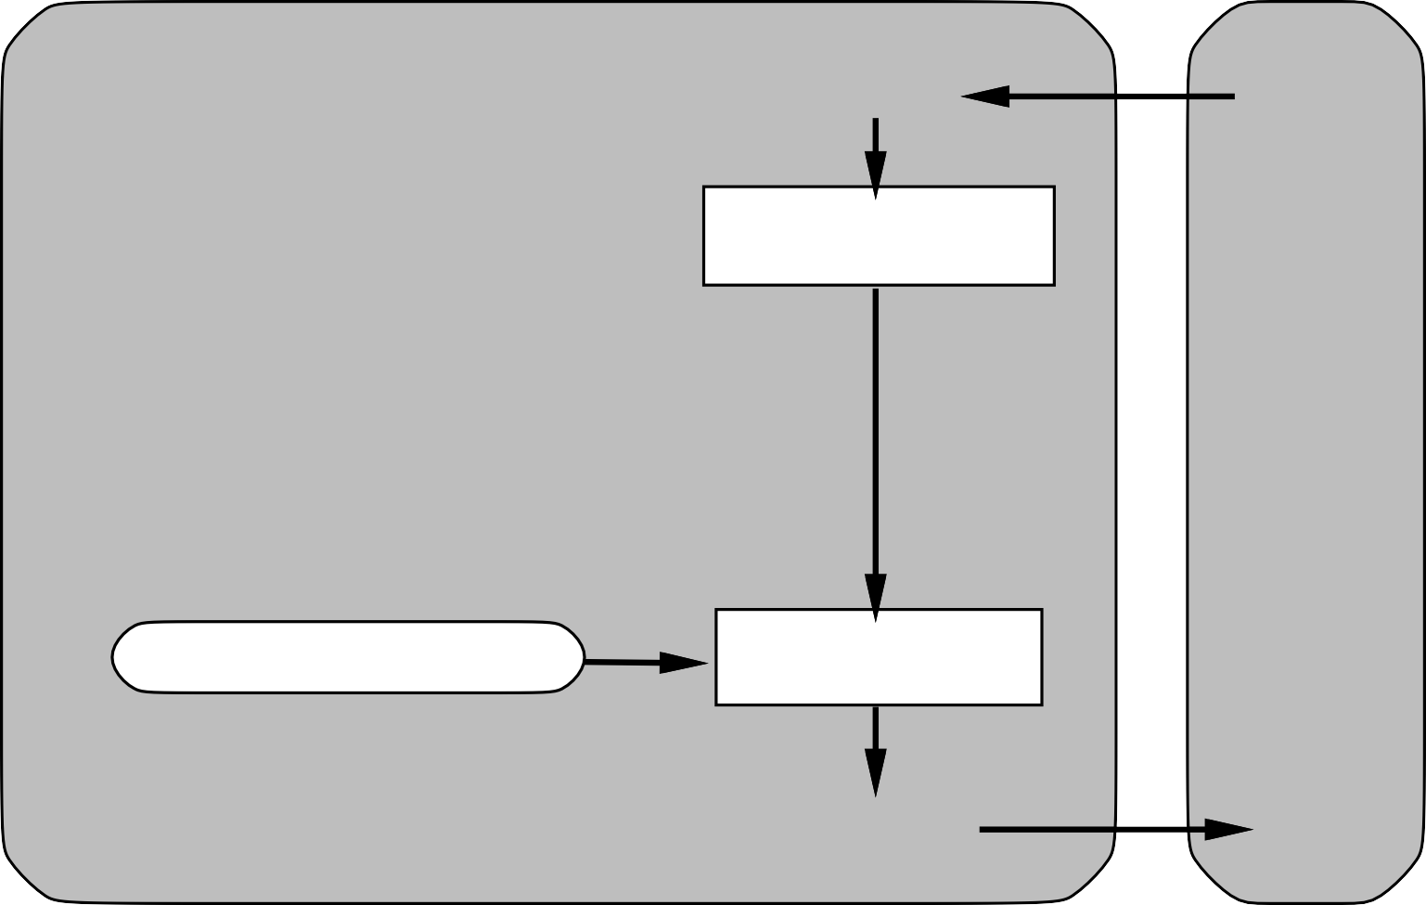
Simple reflex agents
Agent
Sensors
What the world is like now
Environment
Condition−action rules
What action I should do now
Actuators

Slide 27
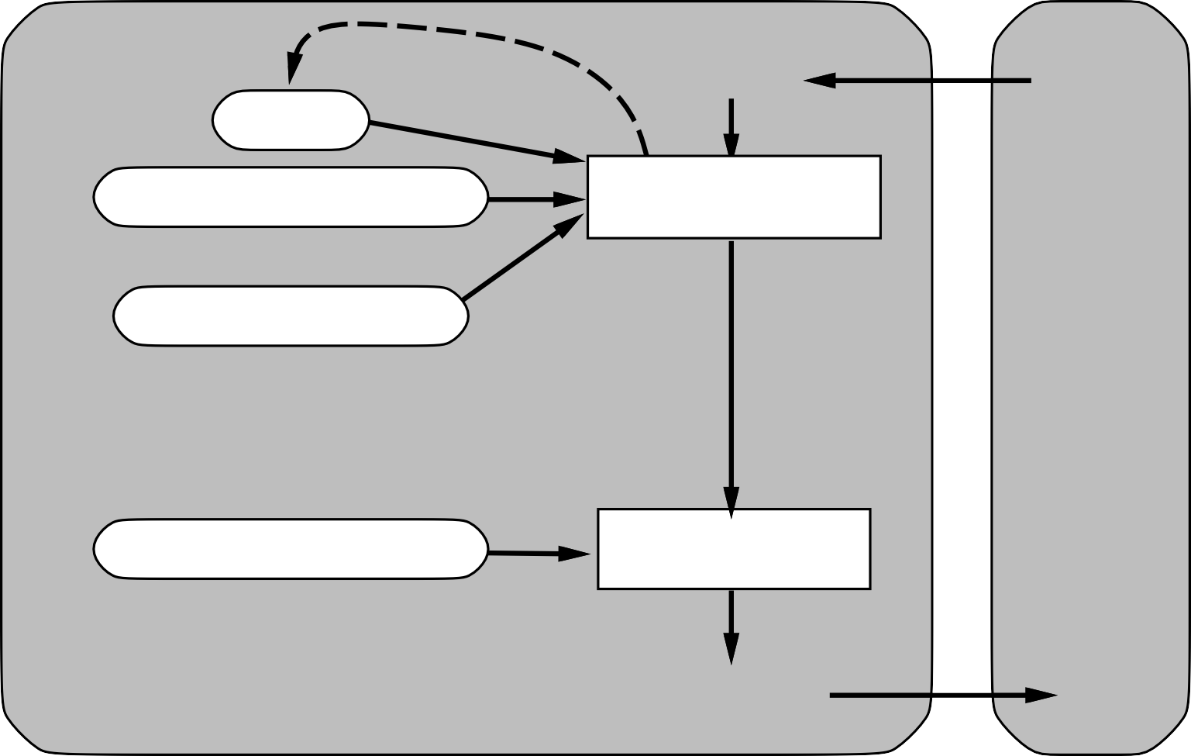
Reflex agents with state
Sensors
State
How the world evolves
What the world is like now
Environment
What my actions do
Condition−action rules
What action I should do now
Agent
Actuators

Slide 28

Model-based agents
Sensors
State
How the world evolves
What the world is like now
Environment
What my actions do
Goals
What action I should do now
Agent
Actuators

Slide 29
Goal-based agents
Sensors
State
How the world evolves
What the world is like now
Environment
What my actions do
What it will be like if I do action A
Goals
What action I should do now
Agent
Actuators

Slide 30

Utility-based agents
Sensors
State
How the world evolves
What the world is like now
Environment
What my actions do
What it will be like if I do action A
Utility
How happy I will be in such a state
What action I should do now
Agent
Actuators

Slide 31
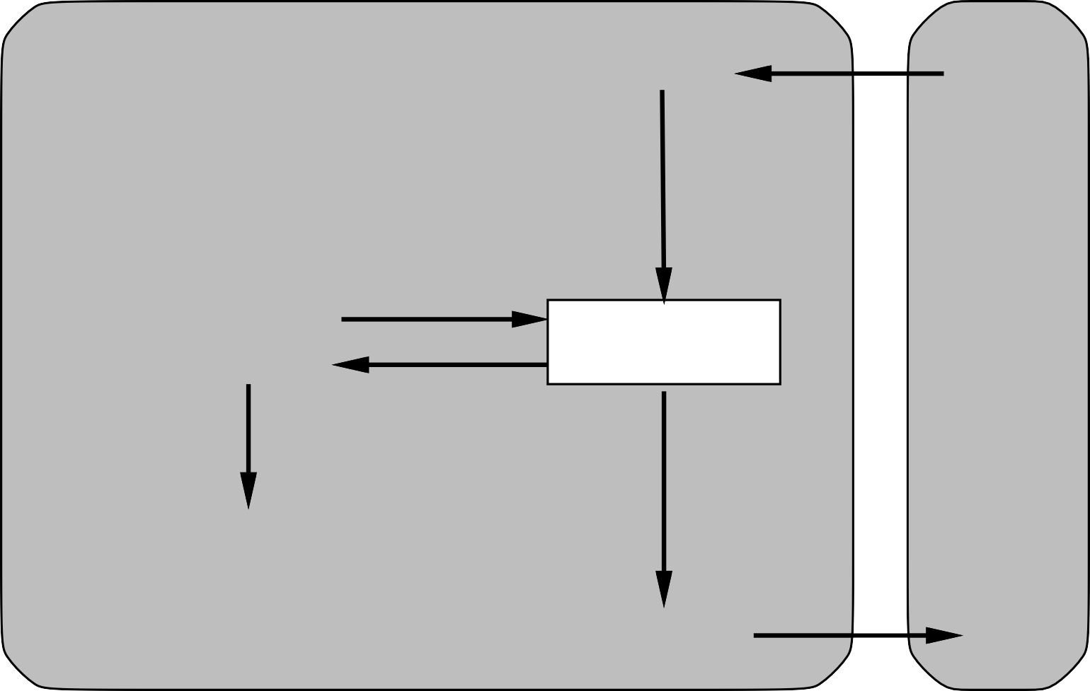
Learning agents
Performance standard
Critic
Sensors
feedback
changes
Environment
Learning element
Performance element
knowledge
learning goals
Problem generator
Agent
Actuators

Slide 32
State of the art
Which of the following can be done at present?
Play a decent game of table tennis
Drive safely along a curving mountain road
Drive safely along Telegraph Avenue
Buy a week’s worth of groceries on the web
Buy a week’s worth of groceries at Berkeley Bowl
Play a decent game of bridge
Discover and prove a new mathematical theorem
Design and execute a research program in molecular biology
Write an intentionally funny story
Give competent legal advice in a specialized area of law
Translate spoken English into spoken Swedish in real time
Converse successfully with another person for an hour
Perform a complex surgical operation
Unload any dishwasher and put everything away

Slide 33
Risks and Benefits of AI
“First solve AI, then use AI to solve everything else.” Demis Hassabis, CEO of Google DeepMind
Benefits:
Decrease repetitive work
Increase production of goods and services
Accelerate scientific research (disease cures, climate change and resource shortages solutions)
Risks:
Lethal autonomous weapons
Surveillance and persuasion
Biased decision making
Impact on employment
Safety-critical applications
Cybersecurity threats

Slide 34
Summary
Agents interact with environments through actuators and sensors
The agent function describes what the agent does in all circumstances The performance measure evaluates the environment sequence
A perfectly rational agent maximizes expected performance Agent programs implement (some) agent functions
PEAS descriptions define task environments Environments are categorized along several dimensions:
observable? deterministic? episodic? static? discrete? single-agent?
Several basic agent architectures exist:
reflex, reflex with state, goal-based, utility-based
There are some risks but enormous benefits and we do not need to be afraid of AI!

